Slide 1
ENHANCING BEST PRACTICE
IN HEALTH AND SAFETY
PETER CORFIELD
DIRECTOR GENERAL
THE NATIONAL ASSOCIATION OF STEEL SERVICE CENTRES
CO-ORDINATION MEETING OF NATIONAL FEDERATIONS, DUSSELDORF
25TH FEBRUARY 2016

Slide 2
AGENDA
HEALTH AND SAFETY PERFORMANCE MEASUREMENT
UPDATE ON HEALTH AND SAFETY ISSUES

Slide 3
HOW DO YOU MEASURE HEALTH AND SAFETY PERFORMANCE?
ACCIDENT FREQUENCY RATIO
NUMBER OF INCIDENTS
OTHER METRICS

Slide 4
ENHANCING BEST PRACTICE IN HEALTH AND SAFETY
ASSUME THE BASICS ARE IN PLACE
TO CONTINUOUSLY IMPROVE AND MAINTAIN MOMENTUM REQUIRES FOCUS
BUSINESSES SHOULD THEREFORE CONSIDER AND EMBRACE
BEHAVIOURAL SAFETY
NEAR MISS REPORTING

Slide 5
BEHAVIOURAL SAFETY
A NATURAL PROGRESSION TO REDUCE AND ELIMINATE ACCIDENTS

Slide 6
WHAT IS BEHAVIOURAL SAFETY?
80% OF ACCIDENTS ARE CAUSED BY UNSAFE BEHAVIOUR
ACCIDENTS RESULT FROM INTERACTION OF UNSAFE BEHAVIOUR WITH “HAZARDS”
THE PRESENCE OF SAFETY SYSTEMS, RISK CONTROLS AND PROCEDURE MONITORING REDUCE ACCIDENTS
BUT EVENTUALLY “PLATEAU” AND STAGNATE

Slide 7
WHY CONSIDER BEHAVIOURAL SAFETY?
IT FOCUSES ON AT-RISK BEHAVIORS THAT CAN LEAD TO INJURY
IT FOCUSES ON SAFE BEHAVIORS THAT CAN CONTRIBUTE TO INJURY PREVENTION
IT INFLUENCES CULTURE OF A BUSINESS THROUGH ATTITUDES AND PERCEPTIONS

Slide 10
HUMAN FAILURES IN ACCIDENTS
HUMAN ERROR IS NOT A CAUSE OF FAILURE. IT IS THE EFFECT, OR SYMPTOM OF DEEPER ROOTED ISSUES
HUMAN ERROR IS NOT THE CONCLUSION OF AN INVESTIGATION. IT IS THE STARTING POINT

Slide 11
VIDEO EXERCISE
TWO TEAMS (WHITE AND BLACK SHIRTS) OF THREE PASSING A BASKETBALL
COUNT THE NUMBER OF PASSES BY THE TEAM IN WHITE SHIRTS
CATEGORISE THEM – AIR PASSES AND BOUNCE PASSES

Slide 12
BASKETBALL VIDEO CLIP

Slide 13
PEOPLE ARE FALLIBLE!!!
WHAT DID HAPPEN?
WHITE TEAM 12 AIR PASSES, 2 BOUNCE PASSES
RECOGNISE PEOPLE’S FALLIBILITY
WHAT WAS HE THINKING?
WHY DIDN’T HE SEE….
HE SHOULD HAVE….

Slide 14
BEHAVIOURAL SAFETY SUMMARY
THERE ARE DIFFERENT TYPES OF UNSAFE BEHAVIOUR
ERRORS AND VIOLATIONS
EVERYONE MAKES MISTAKES
DO NOT LET ONE ERROR CAUSE A DISASTER
AN INDIVIDUAL’S BEHAVIOUR SHOULD NOT BE CONSIDERED IN ISOLATION
SYSTEMS, LEADERSHIP AND CULTURE ARE KEY INFLUENCERS

Slide 15
NEAR MISS REPORTING
A MISSING LINK IN SAFETY CULTURE

Slide 16
WHAT IS A NEAR MISS?
AN UNPLANNED EVENT THAT DID NOT RESULT IN
AN INJURY
ILLNESS
DAMAGE TO EQUIPMENT/PROPERTY

Slide 17
WHY IS NEAR MISS REPORTING IMPORTANT?
INVESTIGATING NEAR MISSES IS CRITICAL TO PREVENT ACCIDENTS.
BECAUSE…
NEAR MISSES SHARE CAUSAL FACTORS AND ROOT CAUSES OF ACCIDENTS.

Slide 18
CAUSAL FACTOR – “HUMAN ERROR OR COMPONENT FAULT FAILURE”
ROOT CAUSE –
“SYSTEM OR PROCEDURE WEAKNESS”

Slide 19
NEAR MISSES ARE WARNINGS!!
CHECKING A NEAR THING…
CAN PREVENT A REAL THING!!

Slide 20
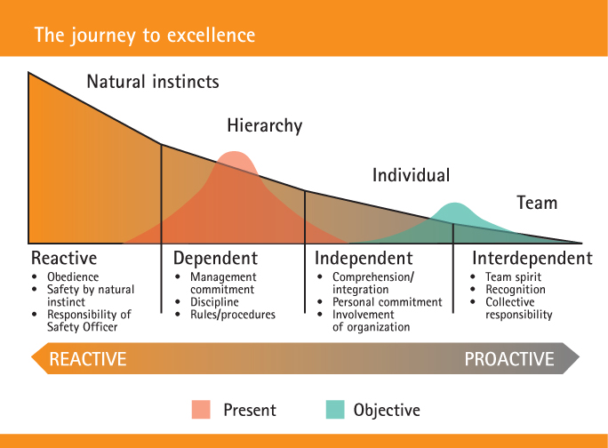
EMBRACING NEAR MISS REPORTING
DUPONT BRADY CURVE MODEL

Slide 21
BARRIERS TO IMPLEMENTATION
LACK OF MOTIVATION
WORK “PRESSURES”
LACK OF UNDERSTANDING

Slide 22
BENEFITS OF NEAR MISS REPORTING
RESOLVES OR ELIMINATES HAZARDS BEFORE THEY BECOME TRAGIC OR COSTLY INCIDENTS.
ENGAGE AND ENCOURAGE THE WORKFORCE TO SOLVE PROBLEMS
INCREASES SAFETY OWNERSHIP AND RESPONSIBILITY
HIGHLIGHTS VALUABLE INFORMATION THAT MAY NOT HAVE BEEN IDENTIFIED FOR RISK ASSESSMENT

Slide 23
“TODAY’S NEAR MISS COULD BE TOMORROW’S FATALITY”

Slide 24
UPDATE ON HEALTH AND SAFETY ISSUES
ISO 14001 REVISION
ISO 45001 DRAFT
CONTROL OF ELECTROMAGNETIC FIELDS AT WORK (EMF)
GB HSE’S 5 YEAR THEMES (2016-2020)

Slide 25
ISO 14001 REVISION
KEY CHANGES
GREATER FOCUS ON LEADERSHIP
INCREASED EMPHASIS ON ENVIRONMENTAL ISSUES
- SUSTAINABILITY
- LIFECYCLE/RECYCLING
- CLIMATE CHANGE

Slide 26
ISO 45001 DRAFT
INTERNATIONAL STANDARD FOR HEALTH AND SAFETY
UNIFORM APPRAISAL –
- LOCAL, NATIONAL, REGIONAL AND GLOBAL
- DEVELOPED AND DEVELOPING COUNTRIES
MINIMISE RISK TO ALL PARTIES, INCLUDING SUPPLY CHAIN
INTEGRATE WITH BUSINESS MANAGEMENT SYSTEMS
PROVIDE AN “UMBRELLA” FOR STRATEGIC MANAGEMENT AND INCORPORATE ISO 9001, ISO 14001 AND OHSAS 18001

Slide 27
ISO 45001 DRAFT
DELIVERABLES
COMMON TRENDS AND DEFINITIONS WILL SIMPLIFY THE PROCESS
REDUCED BUREAUCRACY SHOULD PREVAIL!
BETTER IMPLEMENTATION, INTEGRATION AND MAINTENANCE OF ONE STANDARD
ROBUST MANAGEMENT SYSTEMS IN PLACE WHICH INCORPORATES HEALTH AND SAFETY

Slide 28
ELECTROMAGNETIC FIELDS AT WORK
THE DIRECTIVE AIMS TO PROTECT WORKERS FROM ADVERSE HEALTH EFFECTS ARISING FROM EXPOSURE TO EMF’S
FREQUENCY RANGE 0HZ – 300GHZ
JANUARY 1ST 2016 - EUROPEAN COMMISSION PUBLISHED THE PRACTICAL GUIDE TO THE EMF DIRECTIVE 2013/35/EU
ANY NON COMPLIANCE AFTER JULY 1ST 2016 COULD LEAD TO ENFORCEMENT ACTION

Slide 29
GB HSE 5 YEAR THEMES (2016-20)
PROMOTING BROADER OWNERSHIP OF WORKPLACE HEALTH AND SAFETY
HIGHLIGHTING AND TACKLING THE BURDEN OF WORK RELATED ILL HEALTH
ENABLING PRODUCTIVITY THROUGH PROPORTIONATE RISK MANAGEMENT
SUPPORTING SMALL BUSINESSES
ANTICIPATING AND TACKLING TECHNOLOGY AND METHODS OF WORKING
SHARING THE BENEFITS OF GREAT BRITAIN'S APPROACH

Slide 30
FOR REFERENCE
THIS PRESENTATION AND DETAILED GUIDELINES ON BEHAVIOURAL SAFETY AND NEAR MISS REPORTING CAN BE FOUND ON
THE NASS WEBSITE WWW.NASS.ORG.UK/HEALTHANDSAFETY
OR THE EUROMETAL WEBSITE
WWW.EUROMETAL.NET/INDEX.PHP/HEALTH-AND-SAFETY

Slide 31
PETER CORFIELD – DIRECTOR GENERAL
WPCORFIELD@BTINTERNET.COM
THE NATIONAL ASSOCIATION OF STEEL SERVICE CENTRES
190 CORPORATION STREET
BIRMINGHAM
B4 6QD
TEL: 0121 200 22 88
FAX: 0121 236 7444
WWW.NASS.ORG.UK

