Slide 1
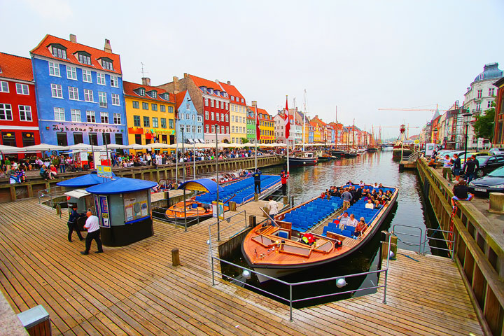
EUROMETAL REGIONAL MEETING NORDICS
TIVOLI HOTEL & CONFERENCE CENTER
COPENHAGEN 08 JUNE 2017
NORDIC STEEL MARKETS AFTER THE CONSOLIDATION
MEETING PROGRAM: STATUS 06.04.17

Slide 2
EUROMETAL REGIONAL MEETING NORDICS COPENHAGEN 08 JUNE 2017 CONFERENCE PROGRAM
08.30: WELCOME DESK OPENS
09.00: THE GENERAL PICTURE
EU INDUSTRY POLICY & EU STEEL TRADE CASES
Aleksandra Kozlowska from EU DG Growth, to be confirmed
THE NORDIC MACRO-ECONOMICS
Chief Economist from a Nordic bank to be invited
10.15 COFFEE BREAK
10.45: DEMAND SIDE SESSION
TRENDS IN WIND ENERGY SECTOR
Speaker to be invited invited
THE FUTURE OF THE NORDIC AUTOMOTIVE INDUSTRY
Speaker from Volvo, or Scandic, or Tier – 1 supplier; to be invited
11.45 SUPPLY SIDE SESSION
PLATE MARKET PERSPECTIVES
CEO of NLMK DANSTEEL; invited
DEVELOPMENTS IN FLAT CARBON MARKETS
Viktor Strömberg, Vice-president Strategy, SSAB
12.45 LUNCH BREAK

Slide 3
EUROMETAL REGIONAL MEETING NORDICS COPENHAGEN 08 JUNE 2017 CONFERENCE PROGRAM
13.45 HRS KEY CHALLENGES FOR NORDIC STEEL DISTRIBUTION
13.45 HRS: PRICING FOR VALUE
Sebastian Strasmann from Simon & Kucher; confirmed
14.15 HRS: Focus on Danish Steel Distribution: Speaker from Danish steel distribution
Focus on Swedish Steel Distribution: Anders Martinsson, CEO BEGROUP
Focus on Finnish Steel Distribution: Speaker from Finnish steel distribution
Focus on Norwegian Steel Distribution: Speaker from Norwegian steel distribution
15.15 HRS: COFFEE BREAK
15.45 HRS: PANEL DISCUSSION ON CHALLENGES FACING IN FUTURE THE SSC BUSINESS
Confirmed panelists: Lars Olsson, Head of Sales Nordic, SSAB Europe
Panelists to be invited from IB Andresen Indistri, Tata Steel Distribution Europe,
ARCELORMITTAL/BEGROUP, … moderated by EUROMETAL President
17.00 HRS: END OF THE MEETING

Slide 4
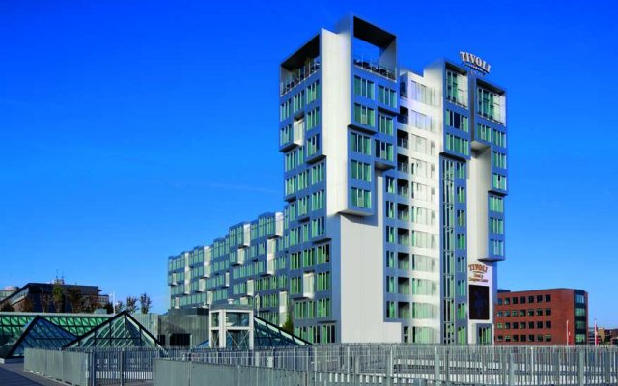
EUROMETAL REGIONAL MEETING NORDICS COPENHAGEN 08 JUNE 2017 HOTEL INFORMATION
TIVOLI HOTEL & CONGRESS CENTER
Arni Magnussons Gade 2 - 4
DK-1577 København V
Web http://www.tivolicongresscenter.dk
Rooms tivolihotel@arp-hansen.dk
Code 1567662
Standard Double Room
1695 DKK

